Slide 1
Micro-Credit Defaulter Model
Use Case

Slide 2
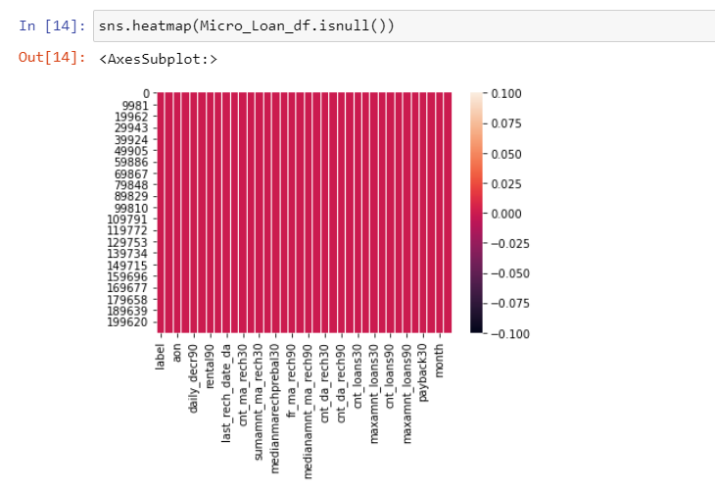
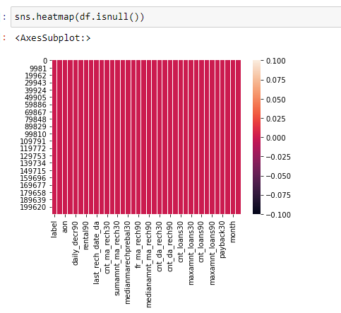
Heat Map Plot

Slide 3
Observation
From Heat Map checking the missing value .
White strip shows for zero value present in Dataset.

Slide 4
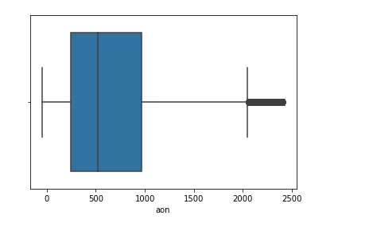
Box Plot
Using Box plot check outliers

Slide 5
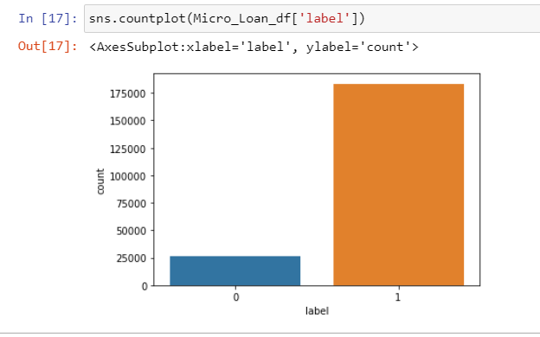
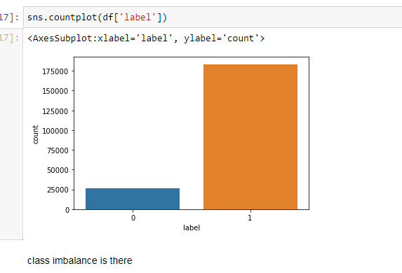
Class Imbalance
Shows class imbalance using count plot (Label is Target columns in categorical from 1 and 0 : . Non- defaulter : Defaulter)

Slide 6
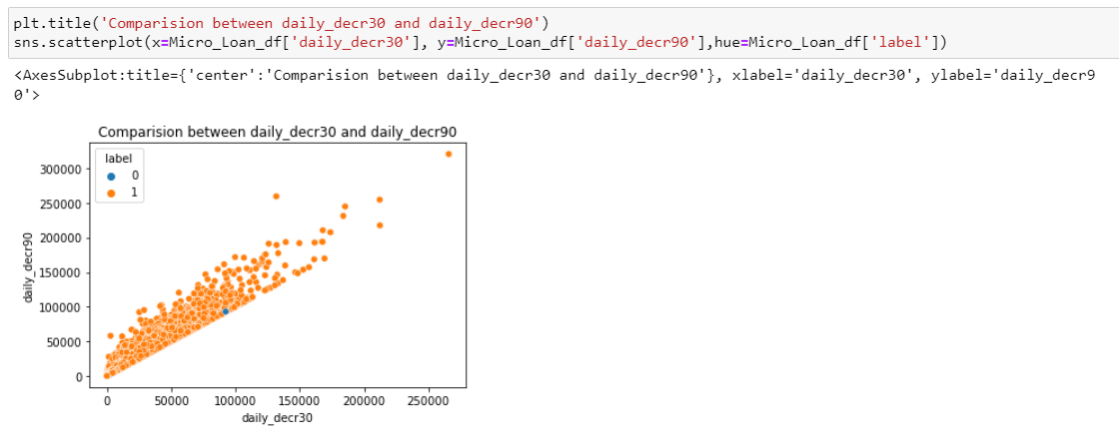
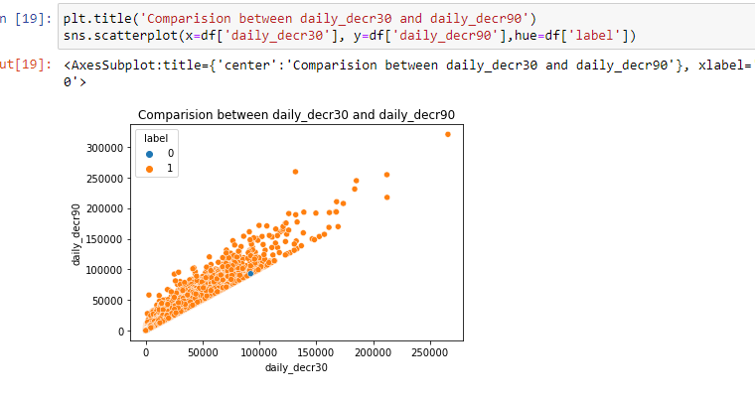
Scatter Plot
Using Scatter plot shown comparison between two columns and rate of success is more showing in orange color

Slide 7
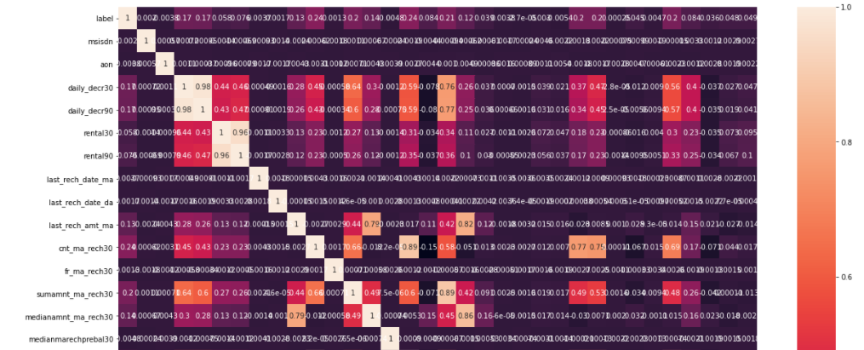
Correlation Matrix
Plot show the relation between the columns

Slide 8
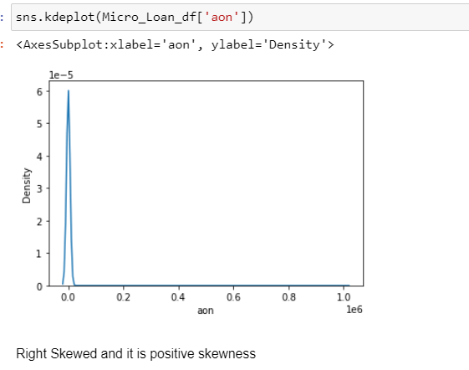
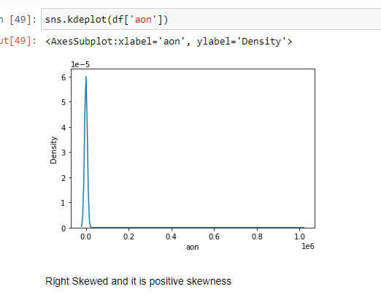
KDE Plot KDE represents the data using a continuous probability density curve in one or more dimensions
Data is Right Skewed more so have to remove some Skewness and it is because of outliers present in dataset

Slide 9
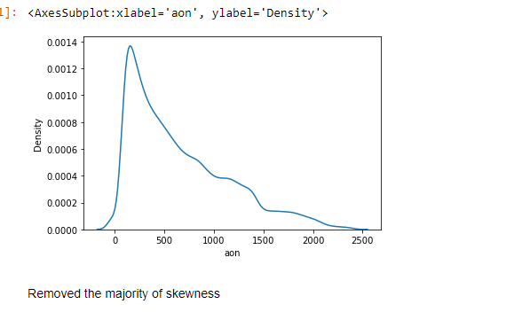
Plot after Removing the majority of Skewness

Slide 10
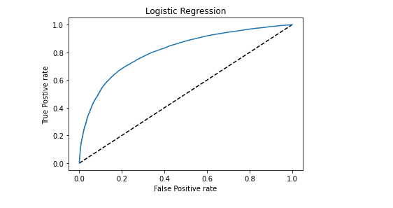
Auc Roc Plot

Slide 11
Thank You

